Slide 1
To Affinity and Beyond
Building a Caring, Engaged Community with Fundraising Intelligence

Slide 2
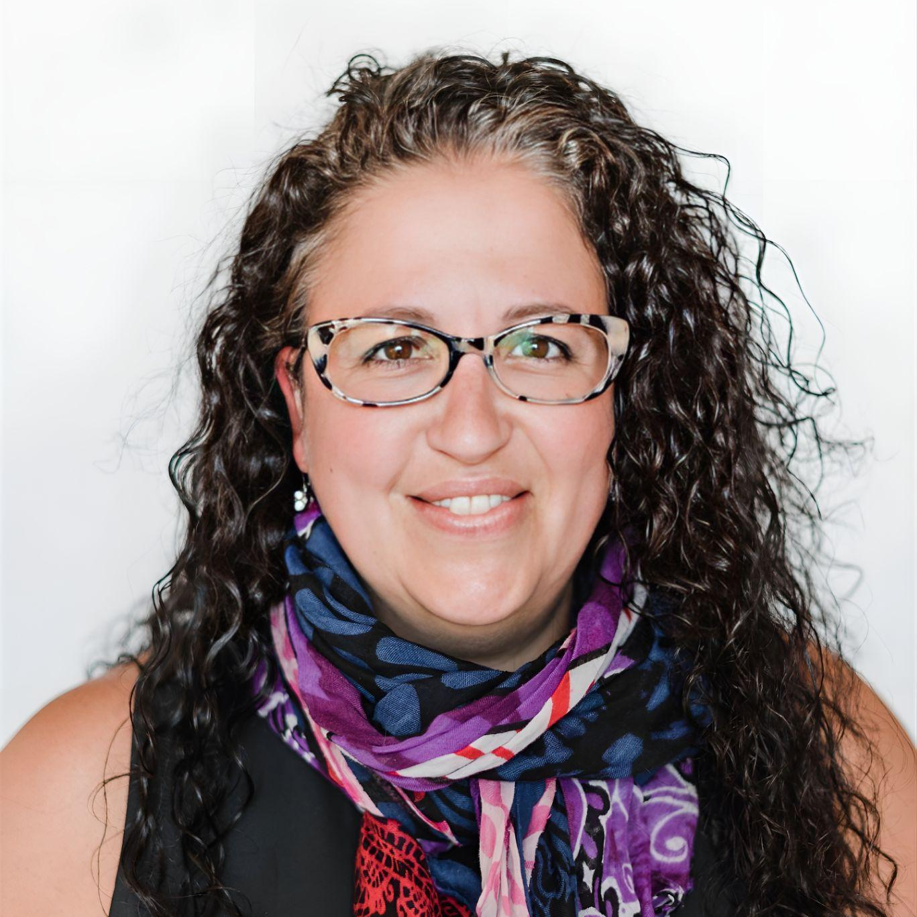
Quick Intro
T. Clay Buck, CFRE
Mary Côté
Lead Fundraising Coach iWave
Founder/Principal TCB Fundraising
iWave’s Vice
President of Product

Slide 3
What We’re Talking About Today . . .
The State of the Sector
What’s Working
What’s Not Working
What Can We Do?
Donor Identity and Fundraising Intelligence

Slide 4
The State of the Sector

Slide 5
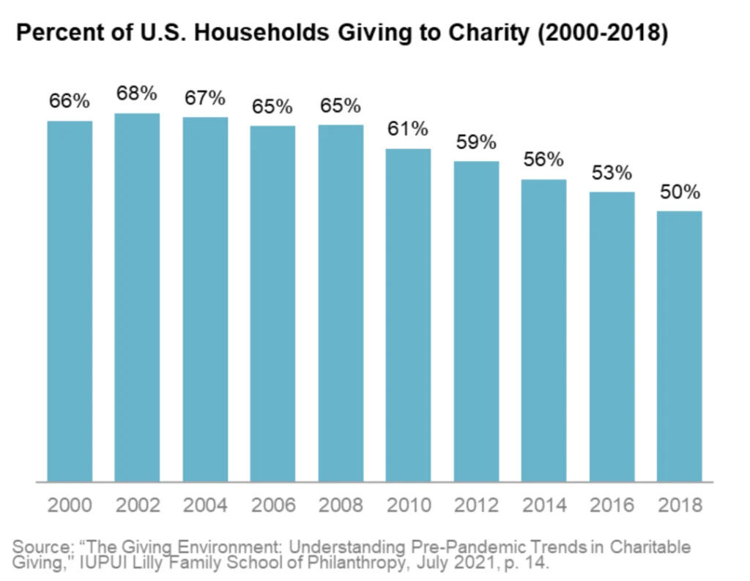
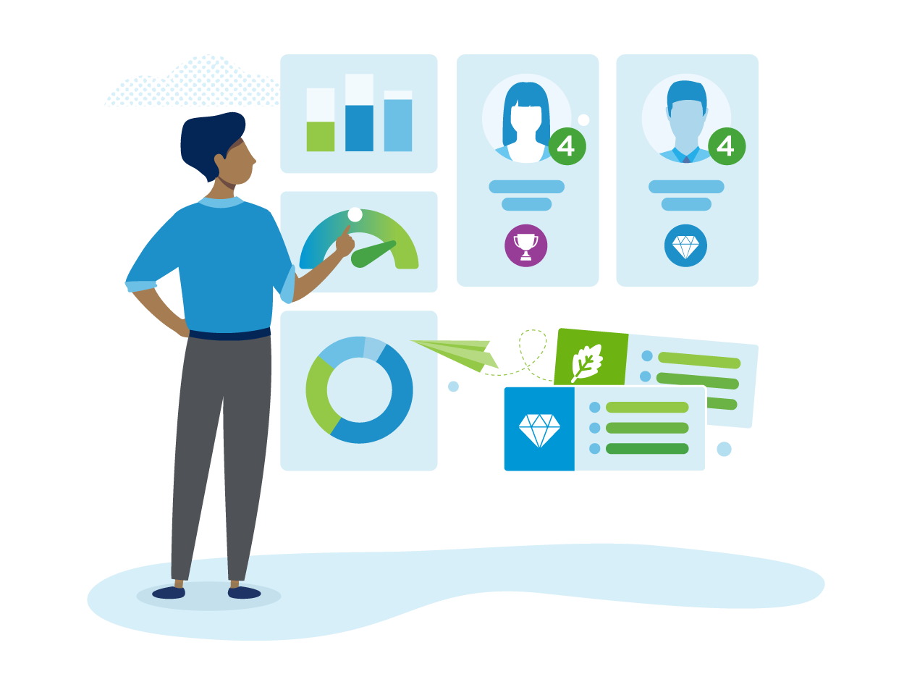
Fewer Households Giving to Charity
Notes:
CLAY

Slide 6
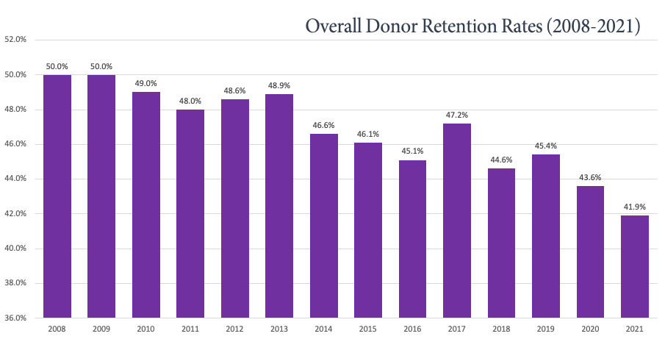
Donor Retention – Fundraising Effectiveness Project
Source: Fundraising Effectiveness Project/TCBFundraising
Notes:
CLAY

Slide 7
Mapping the Global Generosity Ecosystem
Giving Tuesday 2022
Notes:
CLAY

Slide 8
Mapping the Global Generosity Ecosystem
Giving Tuesday 2022
Notes:
CLAY
Engage based on cause not on relationship - the drop in retention and the Giving USA numbers really show us “traditional” fundraising. The question becomes how do we use what we know about donor - generosity - behavior to inform our work and strengthen our missions.
That’s where data - or what we call “Fundraising Intelligence” - comes in. . . .

Slide 9
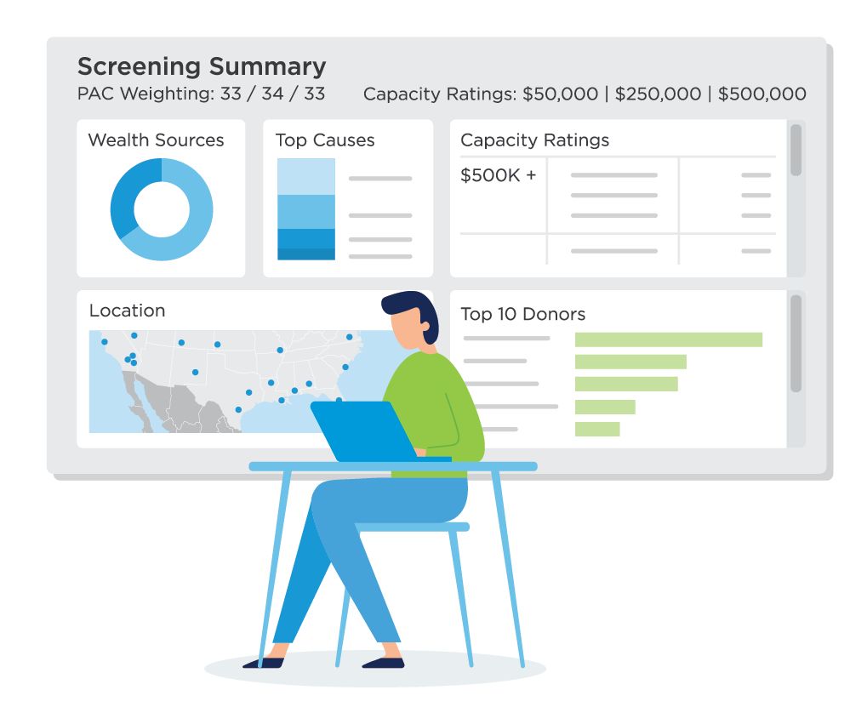
Rise of Data-Driven Fundraising
iWave Clients Completed 50% MORE WEALTH SCREENS in 2022
Notes:
MARY
… And we’re seeing a lot more organizations use fundraising intelligence to make data-informed decisions
One of the interesting trends that we’ve noticed is the rise in the number of screens completed in iWave.
Last year, that number increased by approx. 50%
Although our client base also increased during this period, we can conclude that the demand for screening is up
… and the reason behind it is that more nonprofits are looking to data to support their everyday decisions
Transition: Clay… what’s working?

Slide 10
What’s Working?
Notes:
CLAY

Slide 11
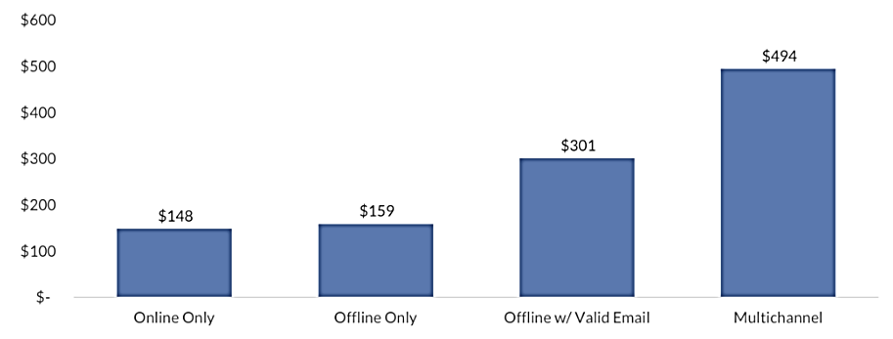
What’s Working in Engaging Donors?
In short . . . Everything.
Source: Brady Josephson, www.nextafter.com/blog/advanced-guide-to-integrated-fundraising/
Notes:
CLAY

Slide 12
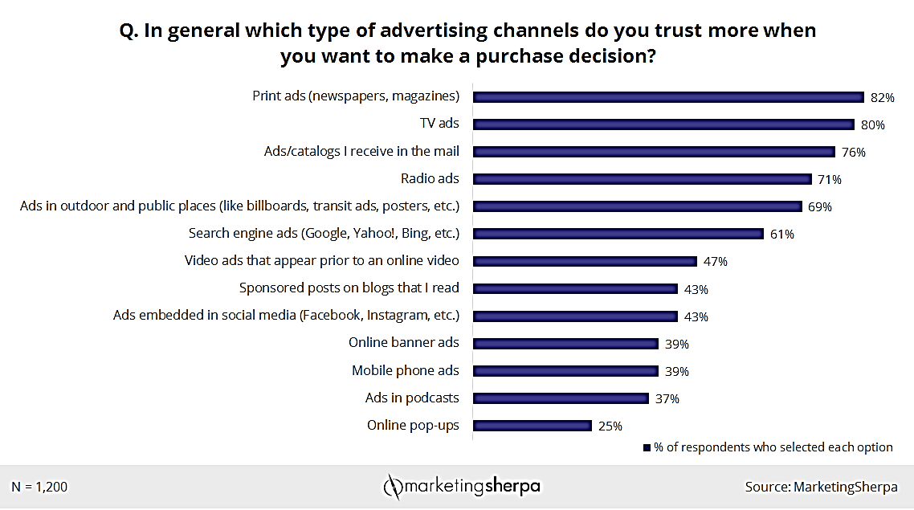
What’s Working in Engaging Donors?
In short . . . Everything.
Notes:
CLAY
Perception that it’s not effective or used anymore, but that’s not true . . .

Slide 13
What’s Working in Engaging Donors?
In short . . . Everything.
Source: Blackbaud Institute 2021 Charitable Giving Report
Notes:
CLAY

Slide 14
What’s Not Working?
Notes:
CLAY

Slide 15
From Giving Tuesday Again . . .
Notes:
CLAY

Slide 16
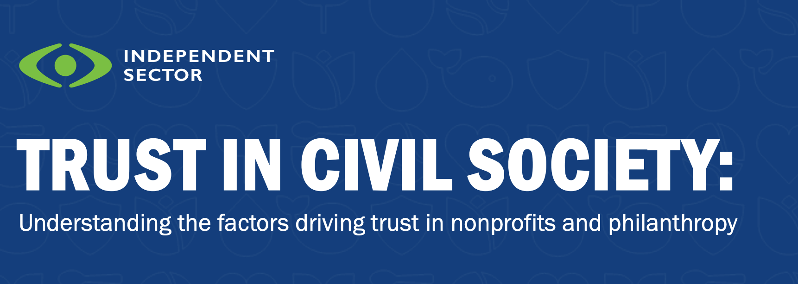
Independent Sector Survey on Trust
Notes:
CLAY

Slide 17
And Because It Bears Repeating . . .
Notes:
CLAY

Slide 18
What Can We Do?
Notes:
CLAY

Slide 19
Giving & Engagement are Fundamentally Human
https://www.charitylink.net/blog/why-donor-identity-matters-for-charities-fundraisers
Notes:
CLAY

Slide 20
Everybody has a story.
When we don’t take the time to know someone’s story – or worse, create our own version of it – we lose the chance to understand what they need, which is the first step to empathy.
Jon Acuff, Author and Speaker
Soundtracks: The Surprising Solution to Overthinking

Slide 21
Identities
Through the lens of Philanthropic Psychology (Drs. Jen Shang & Adrian Sargeant), donors are motivated by the particular identity they’re bringing to the relationship.
Types of donor motivation
Situation-based (external environment motivated)
Relationship-based (motivated by relationship)
Identity-based (motivated by who we are as a human being)

Slide 22
Moral Identity
“a set of moral traits that may be amenable to a distinct mental image of what a moral person is likely to think, feel, and do.”
Aquino, K., & Reed, I. I. (2002)
The self-importance of moral identity. Journal of personality and social psychology

Slide 23
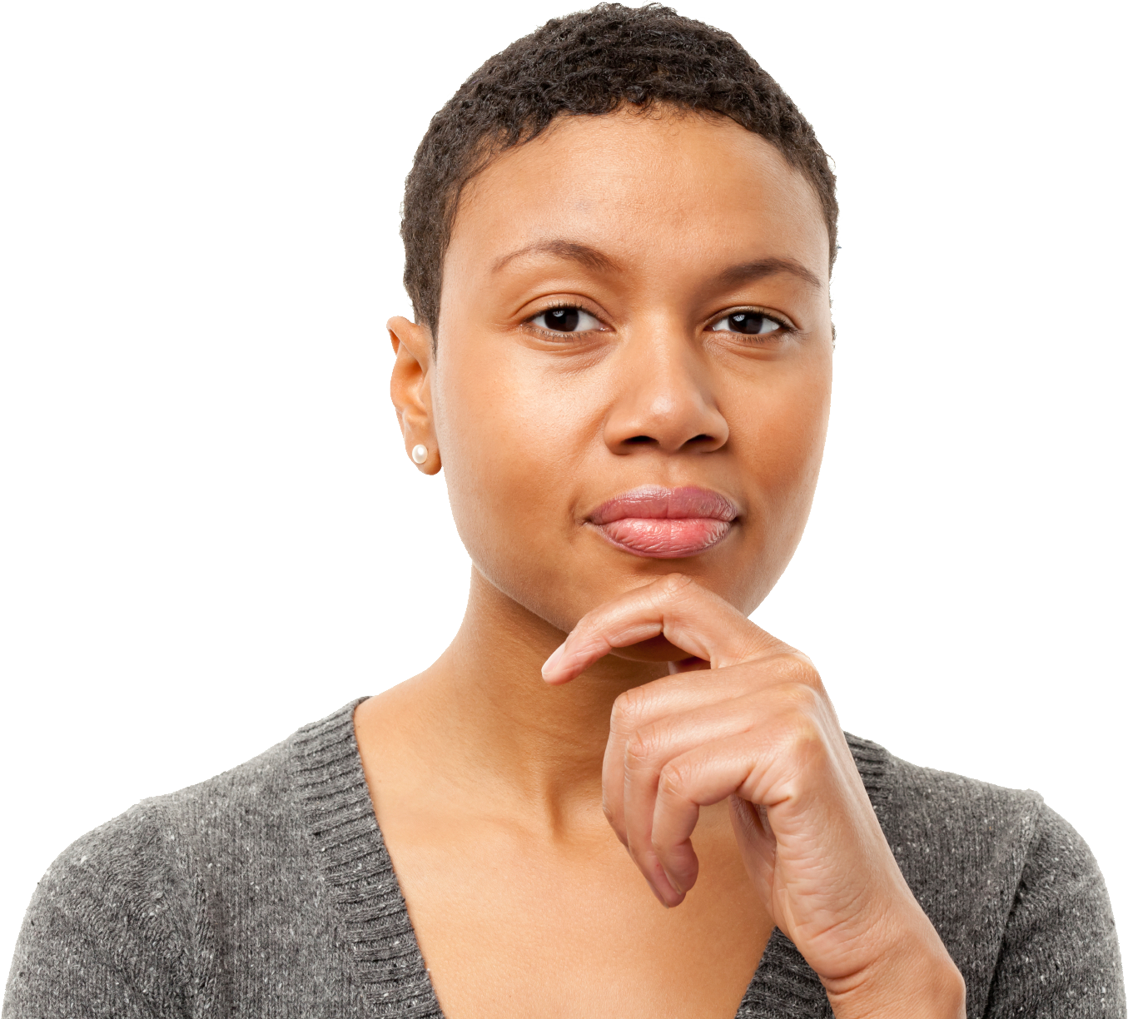
The Most Commonly Cited Traits of a Moral Person
I think I am…
Compassionate
Caring
Fair
Kind
Hardworking
Friendly
Trustworthy
Generous
Helpful

Slide 24
When Any One Thing is Centered, Something Else is Othered
Beneficiary
Our best engagement of donors will factor their values and identities in concert with the values and mission of our organizations – to serve the beneficiaries.
No one part is greater than the other, but all function together to create community.
Donor
Charity
Notes:
CLAY

Slide 25
Donor Identity and Fundraising Intelligence
Notes:
MARY

Slide 26
Fundraising Intelligence
“Business Intelligence for Nonprofits” (Helen Brown, The Helen Brown Group)
Fundraising intelligence, then, is using data to understand our donors, constituents and communities better, listen to their stories, and communicate with them in a way that is meaningful to them.
Notes:
MARY
Some of you may not be familiar with the term “fundraising intelligence”
The best way to understand this term is to think of it as “business intelligence for nonprofits”
In other words… we’re referring to using data to understand our donors, constituents and communities better, listen to their stories, and communicate with them in a way that is meaningful to them

Slide 27
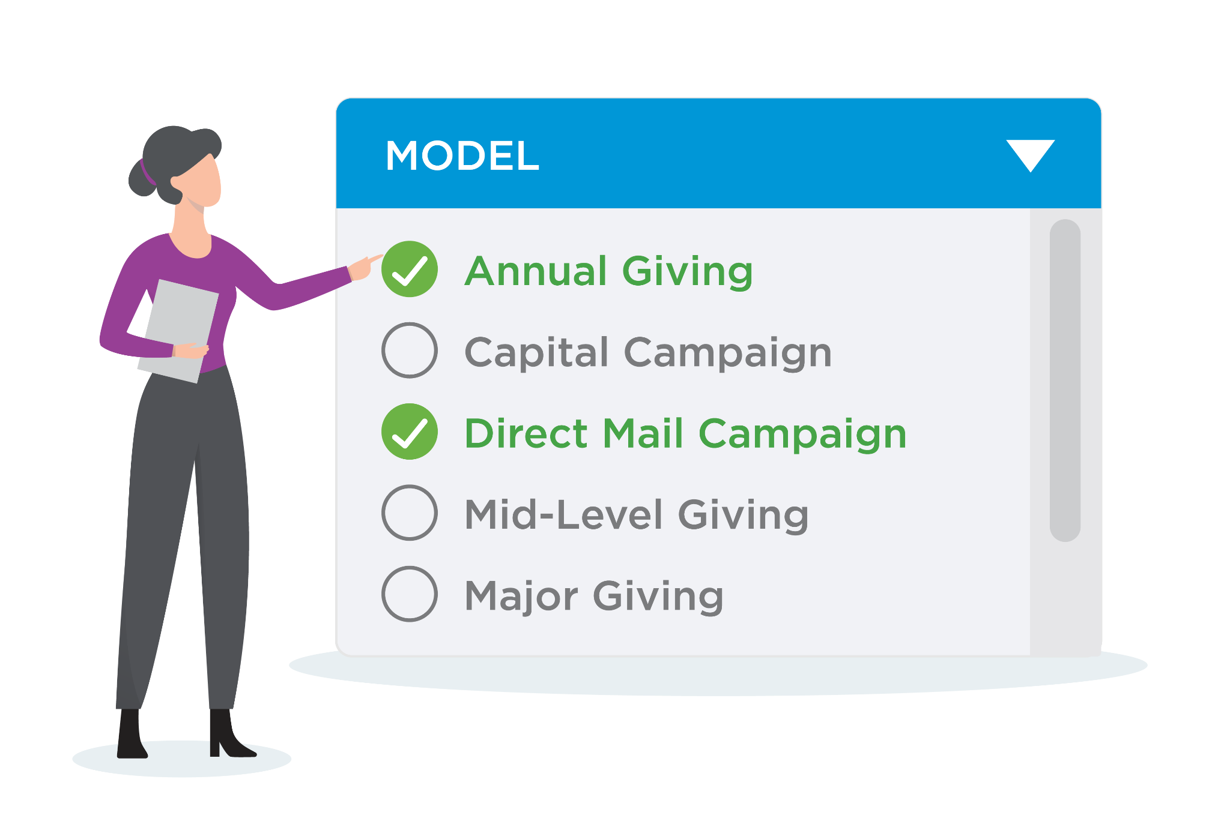
Segment Your Audience Like A Pro
and expand your fundraising opportunities using a diversified approach
Fuel all fundraising strategies, not just major giving, using custom predictive modeling.
Notes:
SEBASTIAN
Fundraising intelligence gives you an almost limitless number of ways to not just segment your audience, but also expand your opportunities using a diversified approach
iWave has a feature that can uncover new giving opportunities across an entire database by matching ideal donors to unique fundraising goals or programs
The way it works is you can setup multiple custom modeling templates, with just a few clicks
And iWave will automatically evaluate your constituents using those parameters and allow you to segment them
Configurable templates include capital campaigns, direct mail, annual giving, and more
You can also develop highly-personalized campaigns by identifying donor affinities that align with campaign goals and use these insights to formulate impactful messaging
Example?

Slide 28
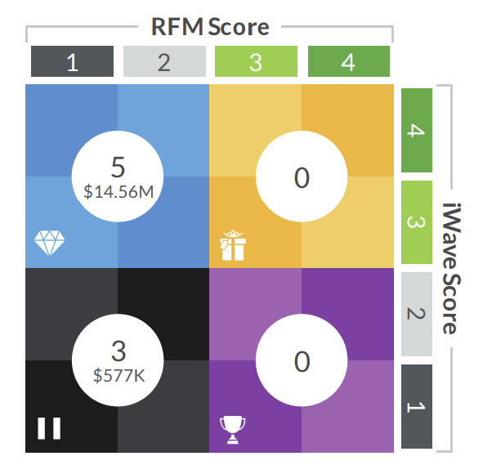
Don’t Treat All Donors The Same
HIDDEN GEMS
DISTINGUISHED
PHILANTHROPISTS
NOT NOW PROSPECTS
YOUR CHAMPIONS
Notes:
MARY
The key with segmentation is that you don’t have to treat all donors the same.. you can take a more strategic approach with your campaigns
In this example, iWave can automatically segment individuals into four groups, based on their philanthropic history with your organization (RFM score), and their wealth and philanthropic history outside of your organization
Hidden gems are major giving prospects in your database that have the capacity to make a major gift and a philanthropic history of supporting your cause
Distinguished philanthropists are major gift donors that donate to your cause but may have additional capacity
Your champions are individuals that donate to your cause but are not on the radar of other nonprofits
And not now prospects are individuals that don’t appear to be philanthropic with any nonprofit

Slide 29
Get to know your donors
better than ever before
Get a 360° view of donors and prospects with the industry’s most comprehensive database of billions of biographic, philanthropic, and wealth data points.
Notes:
MARY
Besides taking a strategic approach to segmenting your database, you can also access a wealth of information (excuse the pun).
We’re talking…
Biographic information: that can help you uncover new contact details, educational background, professional information, alma mater, and connections …
Philanthropic information: … a detailed look into a prospect’s past giving behavior,
So you can understand where and how much they donate… and focus your efforts on individuals that have an affinity for your mission
Wealth information: Gain insight into a prospect’s capacity to give…
You can find wealth indicators, such as real estate holdings, investments, or aircraft ownership… all of which can be used to help formulate data-informed engagement….
CLAY
We used to talk about “wealth screening” - what we know now is that all of this data gets to what we were talking about earlier - what donors, constituents, and communnities are telling us they want - a personalized, meaningful, engaged relationship WITH THE MISSION, regardless of what level of gift they give or how they give, they just want to be involved and feel seen and valued

Slide 30
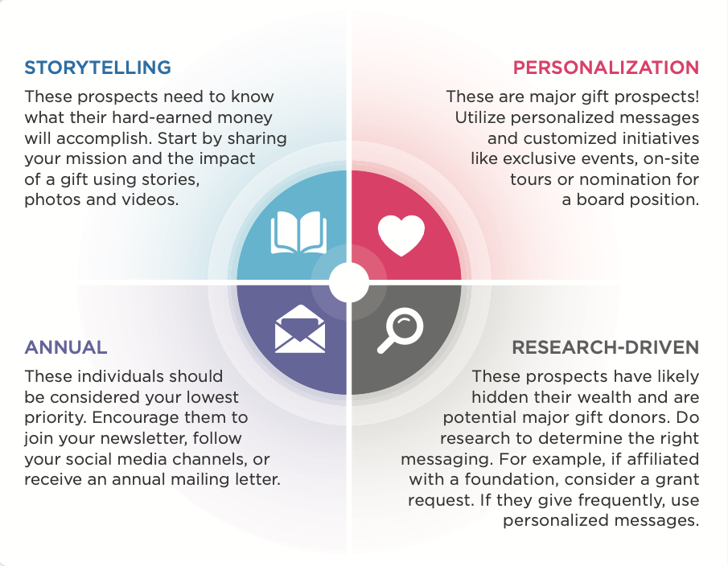
And this is where it really gets interesting . . .
Notes:
MARY and CLAY
How are these Community & Engagement scores derived? – MARY
How do we USE them – CLAY

Slide 31
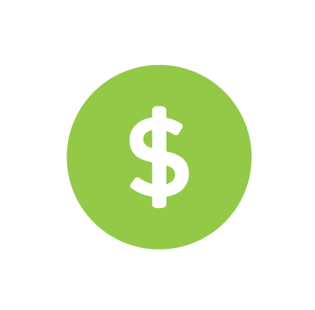
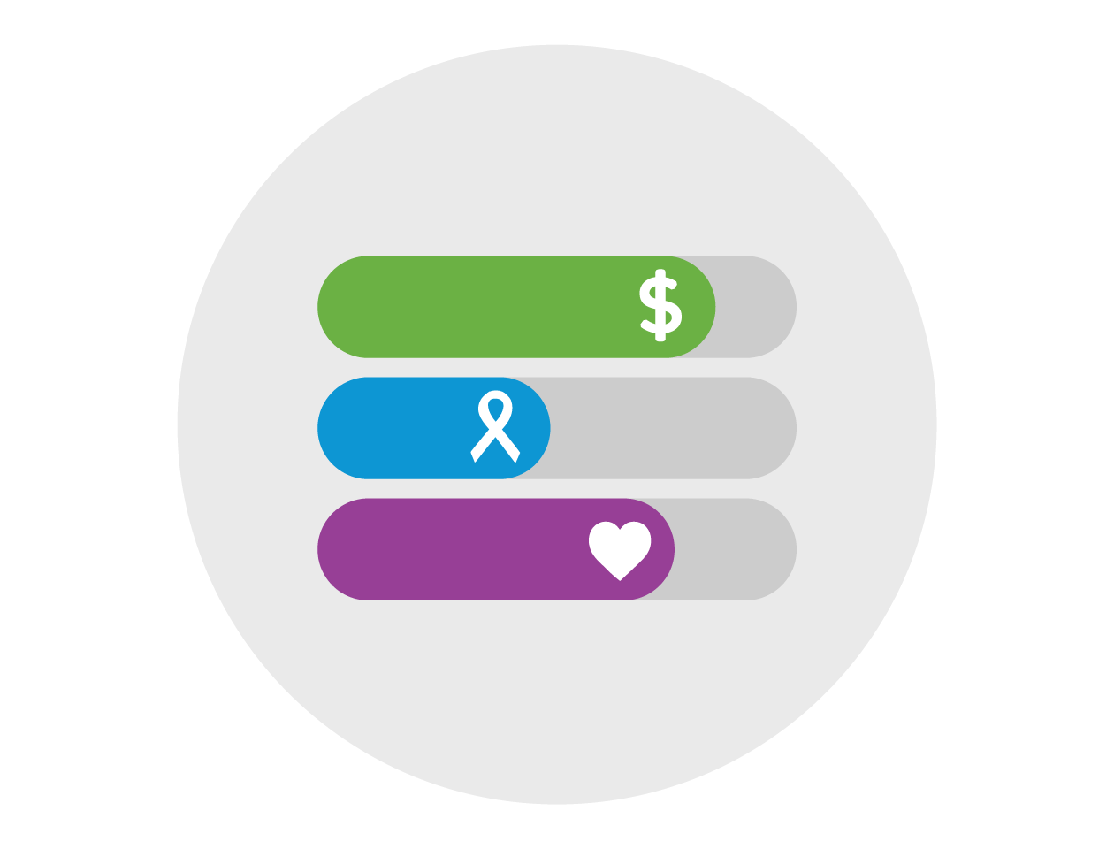
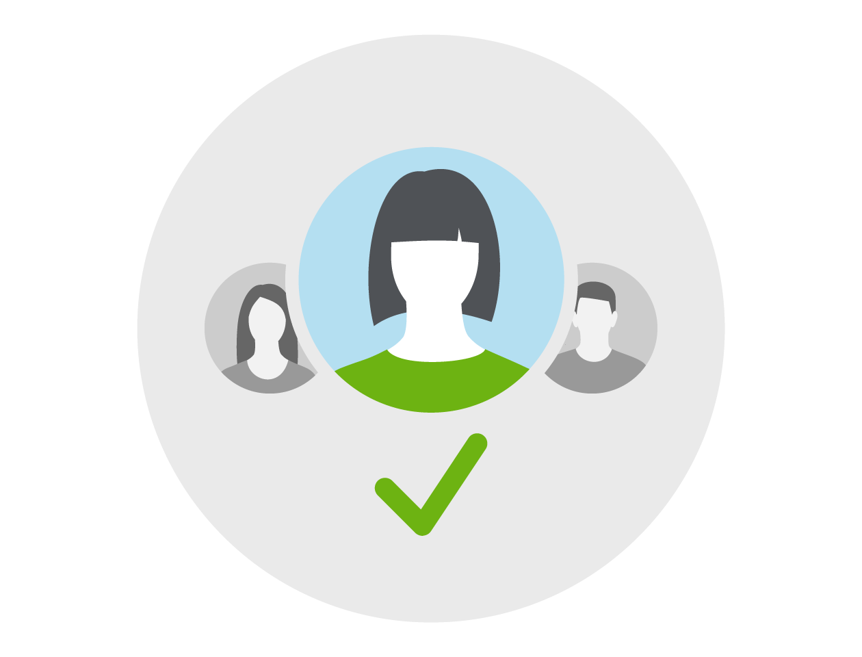
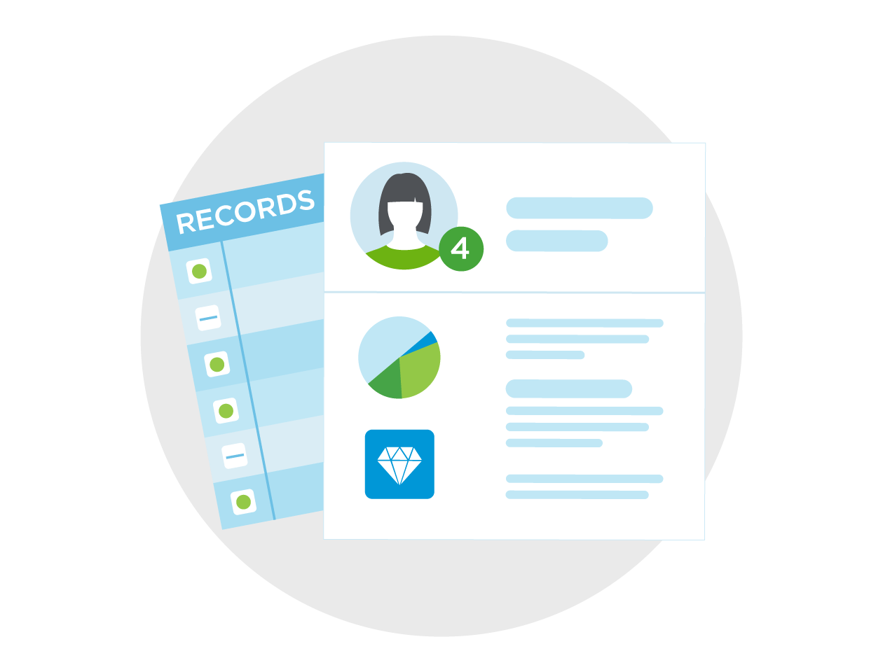
Use Affinity to Personalize Outreach . . .
Propensity
Affinity
Capacity
Notes:
It’s the combination of everything we know - where Affinity - Heart - is really what’s driving the engagement.

Slide 32
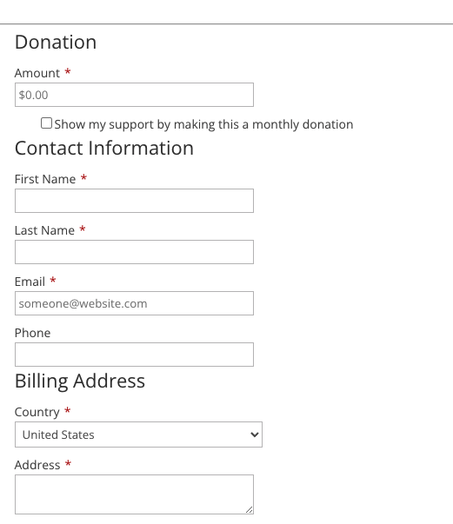
What donors tell us
CLAY
Donors tell us their story in two
fundamental ways:
Their Gift (or lack thereof)
Size/Amount
Frequency
Their Data
Name/Household Information
Contact information
Notes:
CLAY

Slide 33
The power of personalization
Personalized emails led to an average increase of …
Customized calls to action convert …
14%
in click-throughs
202%
better
Source: Hubspot
10%
in conversion rates
Maria, will you make a gift of $150 today to feed a hungry child?
Source: CauseVox
Notes:
Clay

Slide 34
Personalization
44% of donors are willing to give up to 10% more in response to an “individualized experience”(Accenture)
50% increase in direct-mail results using a 1:1 approach (DMA)
Adding a name to your direct mail can increase results by 135% (MailShark)
Notes:
CLAY

Slide 35
How Donors Give
“We can’t necessarily assume the past = future.
The donor journey is deeply personal – donor analysis needs to be, too.”
Noah Barnett, Virtuous
https://pj.news.chass.ncsu.edu/2019/09/09/beyond-rfm-the-key-insights-every-nonprofit-should-know/
Is as important as what they give . . .
Frequency
Urgency
Amount
Channel

Slide 36
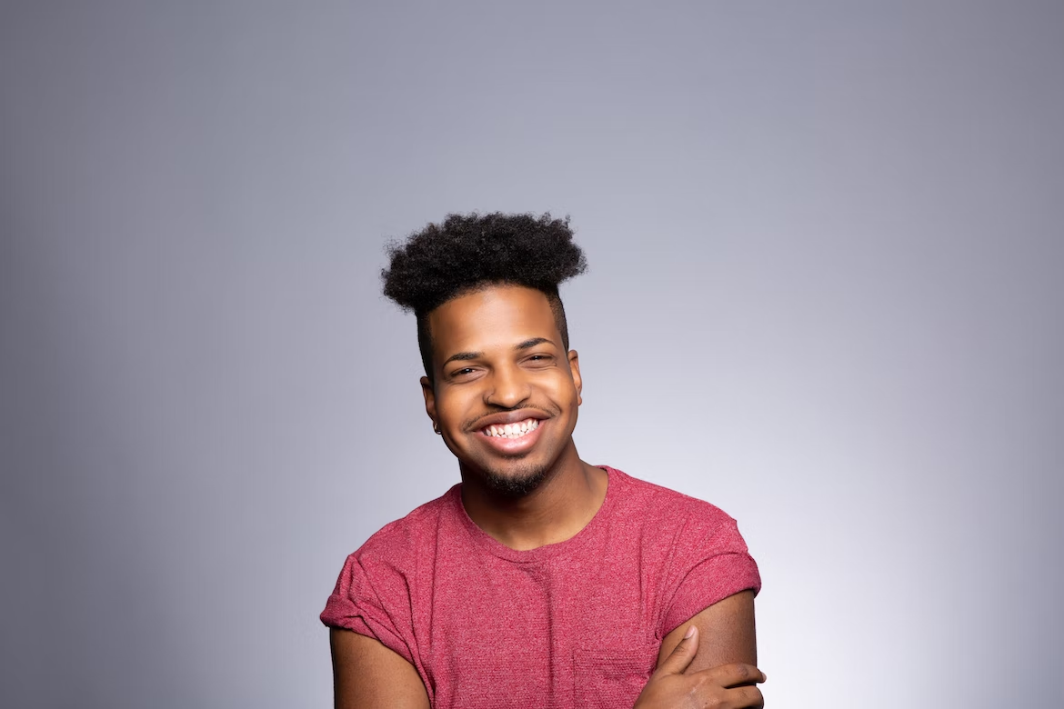
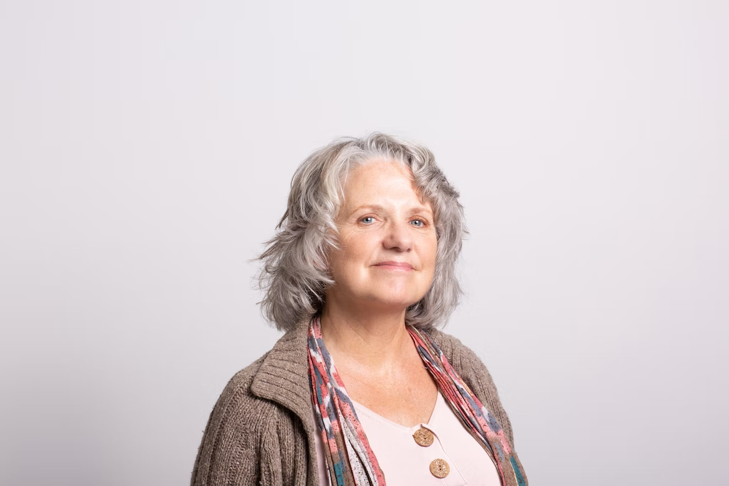
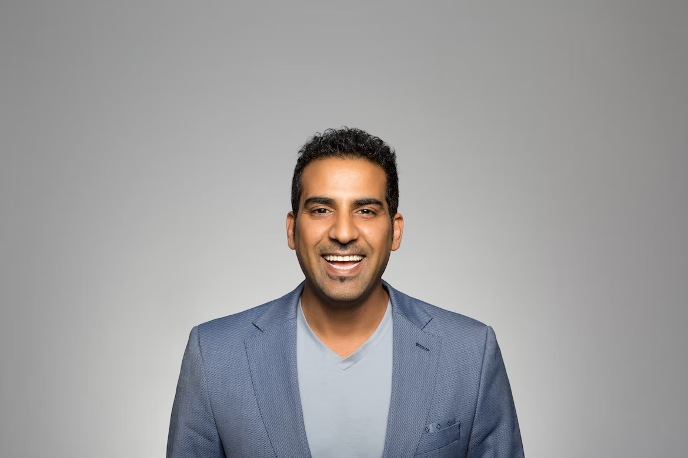
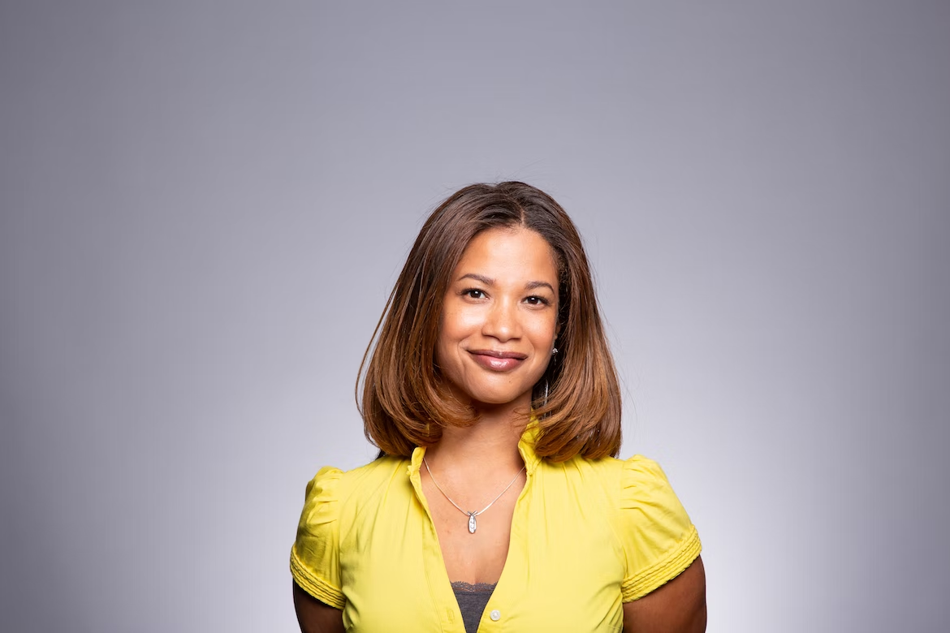
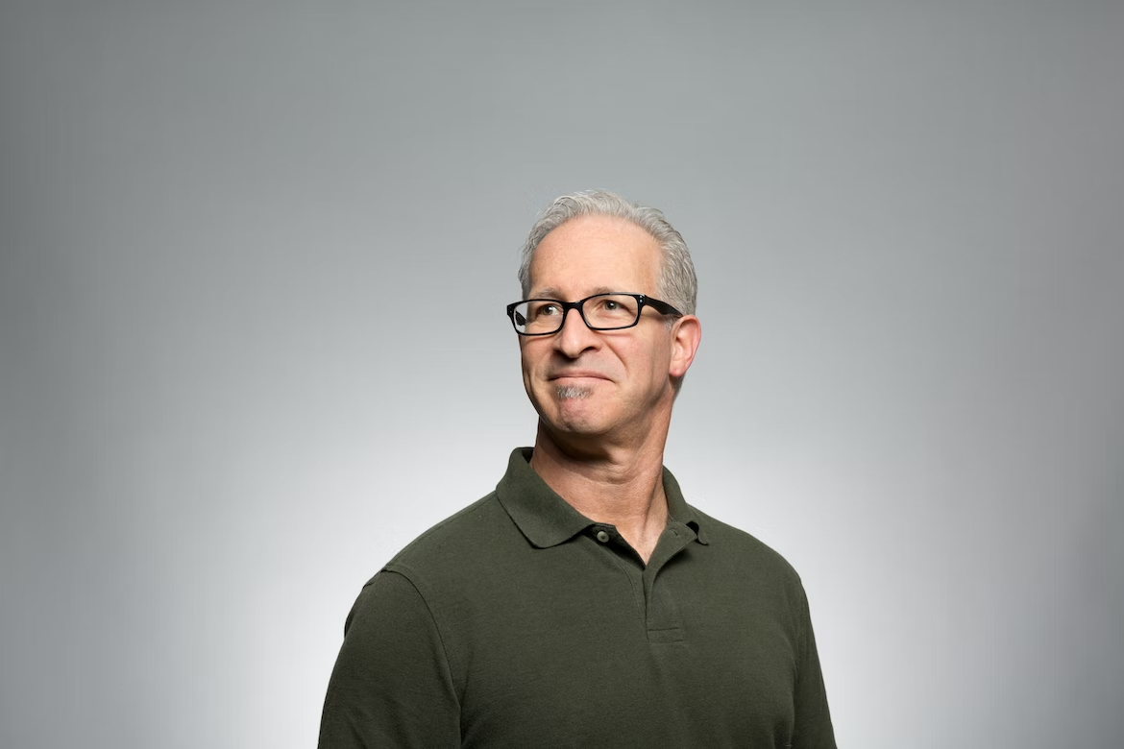
In Other Words . . .
When we’re respecting the integrity of the data a donor provides and using it in our communications, we’re telling them their favorite story – the story about themselves.
Notes:
CLAY

Slide 37
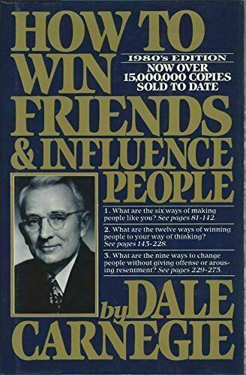
A person’s name is, to that person, the sweetest and most important sound in any language.
Dale Carnegie
How To Win Friends and Influence People

Slide 38
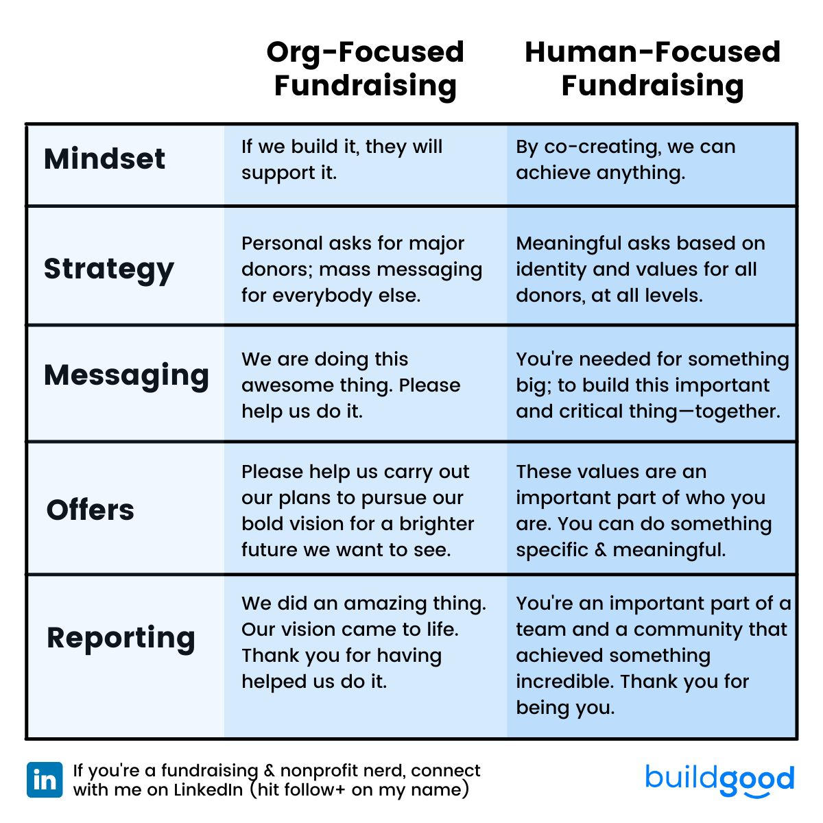
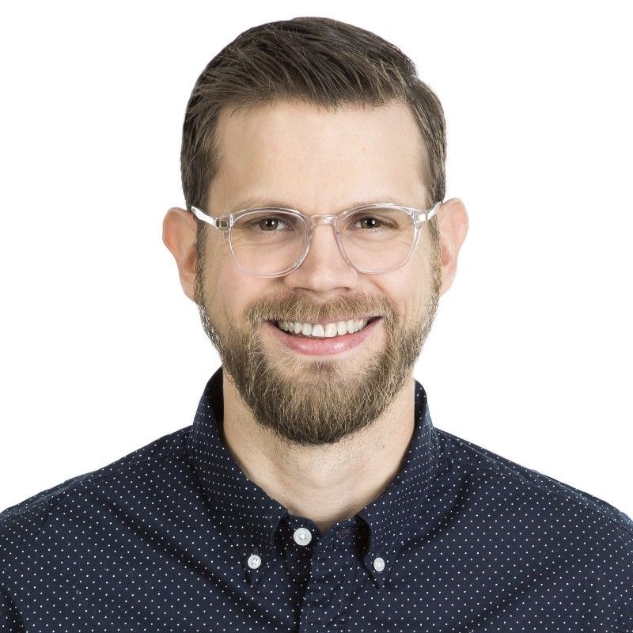
Where Does The Donor’s Story Fit In?
Mike Duerksen, Build Good
www.buildgood.com
www.Linkedin.com/in/mikeduerksen
Notes:
CLAY

Slide 39
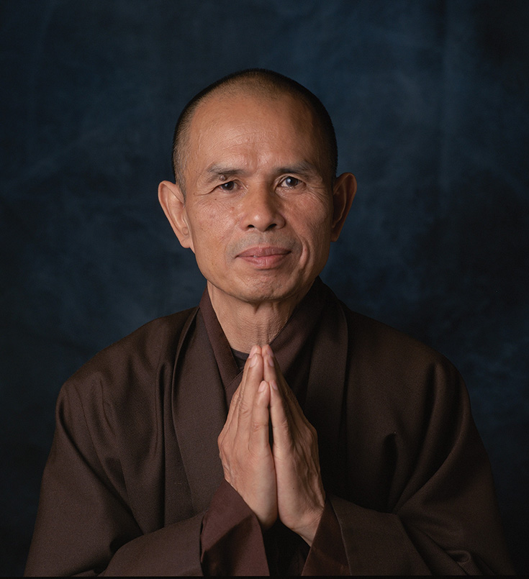
Please call me by my true names, so I can wake up and the door of my heart could be left open, the door of compassion.
Thic Nhat Hanh
Notes:
CLAY

Slide 40
T. Clay Buck, CFRE, clay@tcbfundraising.com Mary Côté, mary.cote@iwave.com
Notes:
CLAY

